Slide 1
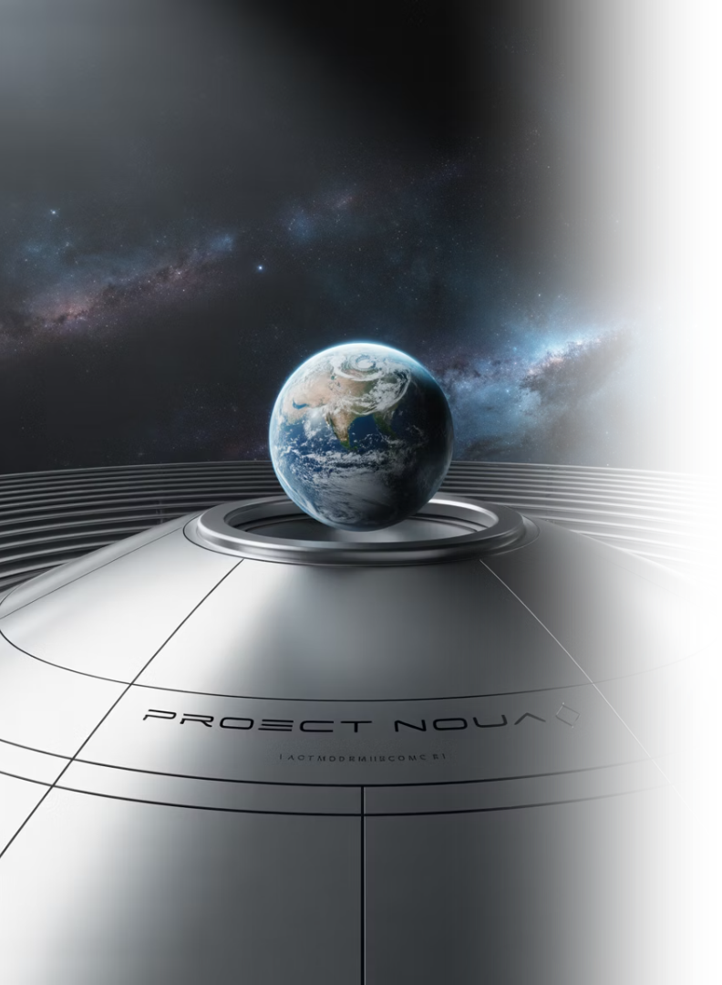
AI in Space
June 8, 2025
by Michael Garcia, Hashim Sayed Hoosini, Miguel Mora

Slide 2
Domain Overview & Importance
Space Domain
AI Necessity
Space = exploration, satellites, data
Large data volumes from space
Supports GPS, weather, defense
Demands automation & accuracy
High risk & high cost missions
AI enables efficient analysis

Slide 3
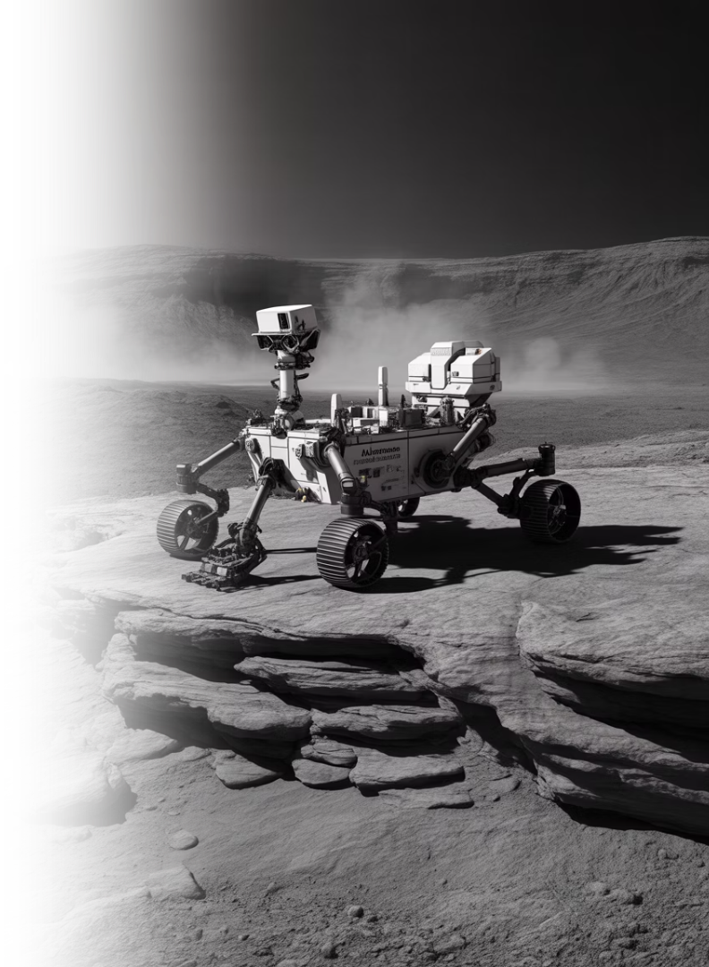



AI Use Case Motivation
Manual data review is slow
Real-time decisions needed in space
Communication delay with Earth
Equipment failure risks lives
AI = autonomy and safety
Example: NASA's Autonomous Exploration for Gathering Increased Science (AEGIS) helps Mars rovers like Curiosity select science targets without Earth commands

Slide 4





AI Techniques Used
CNNs
Reinforcement Learning
Machine Learning
NLP
Convolutional Neural Networks: analyze space images
Anomaly detection on satellites using historical operational data
Processes astronaut communication logs and system reports
Teaches autonomous spacecraft to make decisions through trial-and-error
Robotics + AI: autonomous rovers
2010–Now: rapid AI integration

Slide 5
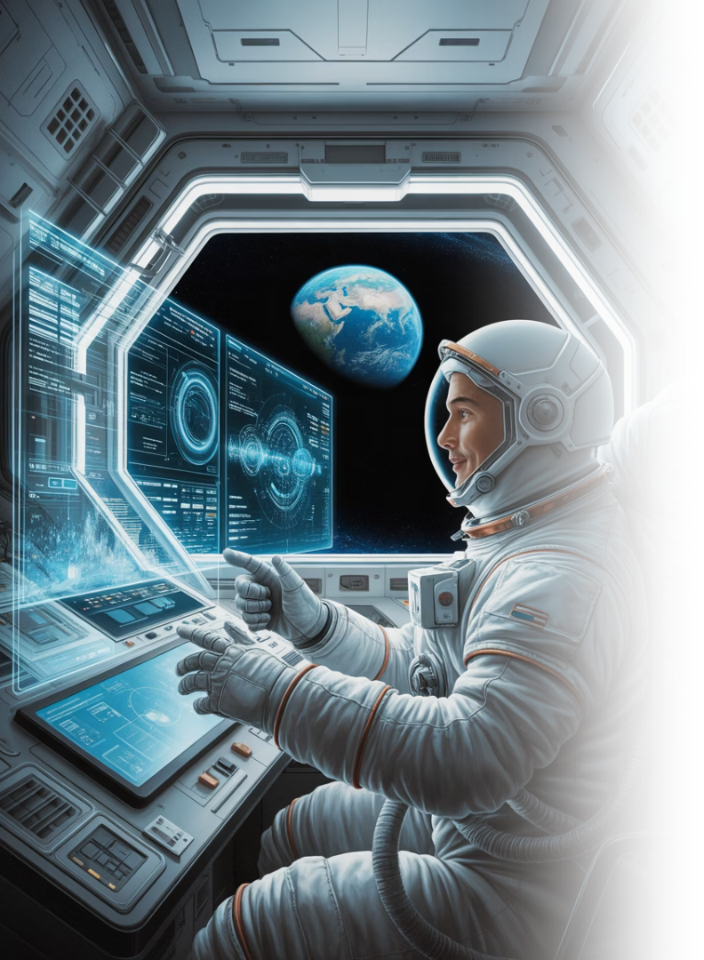
Key Applications
NASA: AEGIS
ESA: Collision Avoidance
Autonomous Exploration for Gathering Increased Science system helps Curiosity choose rocks to analyze
Uses AI to predict and avoid satellite collisions, saving $100M annually
IBM Watson
Assists astronauts with system diagnostics and maintenance on the ISS (International Space Station)
+40% data processing speed via automated image analysis
Reduces manual intervention in mission operations
Enhances planning for Mars and Moon missions

Slide 6

Key application
Precision in Orbit prediction with Neural Network
Orbit prediction is Vital for space operations. It forecasts the position and path of space objects. This process is essential for everything from satellite navigation to collision avoidance. Accurate predication relies on sophisticated data and models.
The foundation of Orbit predication
Data collection
Space surveillance and tracking sensors gather crucial data. They measure the objects position over time. This raw data is the staring point.
Mathematical Models
Sophisticated algorithms process this data . These models account for various force and perturbations. They calculate velocity and
trajectory precisely.

Slide 7
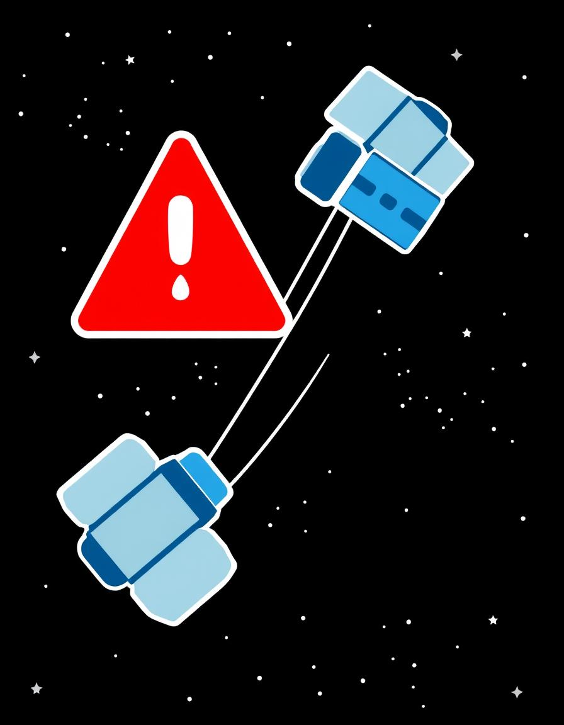
Mitigating collision Risks
Early Warning
Orbit predication provides timely alerts . potential conjunctions are identified early .
Maneuver Planning
Operators plan evasive actions precisely Satellite thrusters preform corrections.
Resource Optimization
Minimalizing propellent use is crucial. Efficient maneuvers save valuable fuel.
Space Sustainability
Proactive avoidance preserves orbit environments. It safeguards future missions.

Slide 8
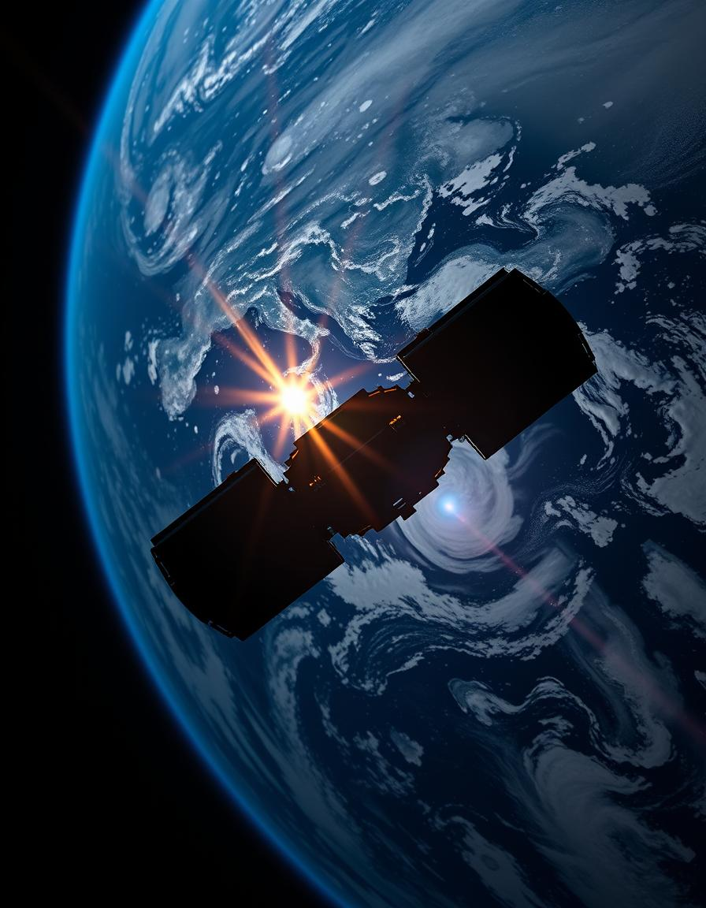
Advancing Space weather Forecasting with Deep Learning
Solar Activity
Solar winds and flares are primary drivers, injecting energy and particle into Earth Upper atmosphere, directly influencing atmospheric density fluctuations.
Atmospheric Drag
Variation in thermosphere density, caused by solar activity , lead to significant changes in drag experienced by satellite, especially those in Low earth orbit.

Slide 9






Impact & Benefits
Faster data insights
Google's AI processes NASA's Kepler data to find new planets
Safer space missions
AI detects battery or sensor issues early on spacecraft
Cost savings
AI reduces failures like ESA's failed Schiaparelli lander
Improved satellite management
LeoLabs uses AI to manage satellite traffic
Faster discovery
AI found exoplanet Kepler-90i from 35,000 signals
Supports deep space autonomy
For Mars, Moon, and asteroid missions

Slide 10










Challenges & Risks
Space data is complex
High-stakes decisions
Limited training datasets
AI failure = mission risk
Communication limits in space
Ethical use in defense space tech

Slide 11






Future Directions
AI co-pilots for spacecraft
Boeing's CST-100 Starliner tested AI assistance
Onboard real-time decision systems
ESA's OPS-SAT testbed
AI + quantum computing
For faster space mission simulations (NASA + Google partnership)
Space debris tracking with AI
LeoLabs, NorthStar AI forecast collisions
AI-led space mining exploration
NASA's asteroid mining concepts using AI path planning
More public-private AI collaborations
SpaceX, Blue Origin with AI R&D

Slide 12










Conclusion
Supports autonomy & efficiency
AI boosts space safety & discovery
Reduces risk and cost
Future: AI as mission partner
Powers next-gen missions

Slide 13






References & Acknowledgments
NASA Jet Propulsion Laboratory. (2022). AEGIS: Autonomous Targeting for Mars Rovers. https://www.jpl.nasa.gov/news/aegis-autonomous-targeting-for-mars-rovers
European Space Agency (ESA). (2021). Collision Avoidance Powered by AI. https://www.esa.int/Safety\_Security/Space\_Debris
IBM. (2020). How Watson Assists Astronauts on the ISS. https://www.ibm.com/blogs/research/2020/02/ai-iss/
Google AI. (2017). Using Machine Learning to Discover Exoplanets. https://ai.googleblog.com/2017/12/announcing-two-new-exoplanets-discovered.html
LeoLabs. (2023). AI-Powered Space Traffic Management. https://www.leolabs.space
NASA & Google. (2019). Quantum Supremacy Applied to Space Missions. https://www.nasa.gov/feature/quantum-computing-and-space-exploration
Boeing. (2021). CST-100 Starliner and AI-Assisted Spaceflight. https://www.boeing.com/space/starliner/
(PDF) Artificial Intelligence for a Safe Space: Data and Model Development Trends in Orbit Prediction and Collision Avoidance, www.researchgate.net/publication/377599847_Artificial_Intelligence_for_a_Safe_Space_Data_and_Model_Development_Trends_in_Orbit_Prediction_and_Collision_Avoidance. Accessed 16 June 2025.
CIMON, the AI-powered robot, launches a new era in space travel | IBM

